Slide 1


Data Management
Tutor: Ms Low Jia Xin Contact: 65500529
Email: low_jia_xin@nyp.edu.sg

Slide 2
Week 6 Topics
Official (Open)
Filtering Data using WHERE Clause
Comparison Operators (Equal, Not Equal, Less than, Greater than, Not)
Other Comparison Operators (AND, OR, BETWEEN...AND, IN, LIKE, ORDER BY, IS NULL / NOT NULL)
DISTINCT
Aggregate function (SUM, AVG, COUNT)
Group by

Slide 3
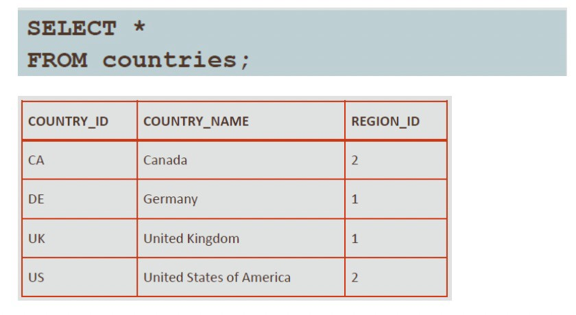
Recap - Retrieving all data using SELECT statement
Official (Open)
SELECT * FROM <tablename> Displays all columns of all rows of data
Notes:
* Mean everything

Slide 4
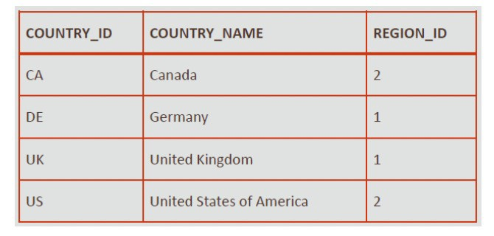
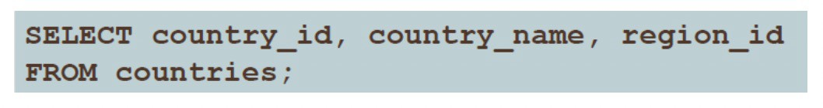
Recap –
Retrieving selected data using SELECT statement
Official (Open)
SELECT <columnname> FROM <tablename> Displays a specific column of all rows of data
SELECT <columnname1> , <columnname2> FROM <tablename> Displays two specific columns of all rows of data.

Slide 5
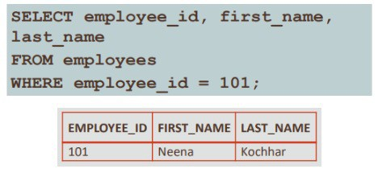
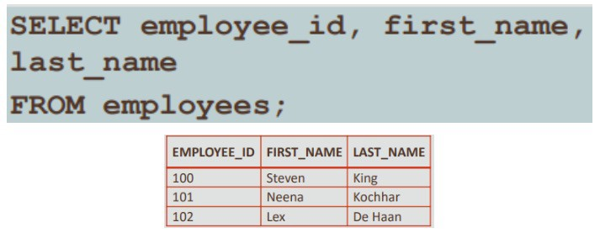
Retrieving data with condition - WHERE clause
Official (Open)
Syntax:
SELECT <columnname(s)> FROM <tablename>
WHERE <column_name> <comparison_condition> <comparison_value>;
Without WHERE clause
With WHERE clause

Slide 6
Table Example
Official (Open)
StudentInfo
Name | Gender | adminNo | Marks
Irfan | M | 111222A | 97
Julia | F | 114435B | 74
Kieran | M | 115623C | 90
Lucy | F | 112419D | 78
Mike | M | 118752E | 56

Slide 7
W HERE option - Equality
Official (Open)
Name | Gender | adminNo | Marks
Irfan | M | 111222A | 97
Julia | F | 114435B | 74
Kieran | M | 115623C | 90
Lucy | F | 112419D | 78
Mike | M | 118752E | 56
= means equal to
Example: SELECT *
FROM StudentInfo WHERE gender=‘M’;
Result:
Name | Gender | adminNo | Marks
Irfan | M | 111222A | 97
Kieran | M | 115623C | 90
Mike | M | 118752E | 56
Notes:
Get data from StudentInfo table where gender is male

Slide 8
WHERE option – Non-equality
Official (Open)
Name | Gender | adminNo | Marks
Irfan | M | 111222A | 97
Julia | F | 114435B | 74
Kieran | M | 115623C | 90
Lucy | F | 112419D | 78
Mike | M | 118752E | 56
<> or != means not equal to
Example: SELECT *
FROM StudentInfo WHERE gender<>‘F’;
Result:
Name | Gender | adminNo | Marks
Irfan | M | 111222A | 97
Kieran | M | 115623C | 90
Mike | M | 118752E | 56
OR Gender !=‘F’;
Notes:
Get data from StudentInfo table where gender is not equal to female

Slide 9
WHERE option – Less Than
Official (Open)
Name | Gender | adminNo | Marks
Irfan | M | 111222A | 97
Julia | F | 114435B | 74
Kieran | M | 115623C | 90
Lucy | F | 112419D | 78
Mike | M | 118752E | 56
< means Less than
<= means Less than or equal to
Example: SELECT *
FROM StudentInfo WHERE Marks < 75;
Result:
Name | Gender | adminNo | Marks
Julia | F | 114435B | 74
Mike | M | 118752E | 56
Notes:
Get data from StudentInfo table where marks is less than 75

Slide 10
WHERE option – Greater Than
Official (Open)
Name | Gender | adminNo | Marks
Irfan | M | 111222A | 97
Julia | F | 114435B | 74
Kieran | M | 115623C | 90
Lucy | F | 112419D | 78
Mike | M | 118752E | 56
> means Greater than
>= means Greater than or equal to
Example: SELECT *
FROM StudentInfo WHERE Marks > 75;
Result:
Name | Gender | adminNo | Marks
Irfan | M | 111222A | 97
Kieran | M | 115623C | 90
Lucy | F | 112419D | 78
Notes:
Get data from StudentInfo table where marks is more than 75

Slide 11
WHERE option – NOT
Official (Open)
Name | Gender | adminNo | Marks
Irfan | M | 111222A | 97
Julia | F | 114435B | 74
Kieran | M | 115623C | 90
Lucy | F | 112419D | 78
Mike | M | 118752E | 56
Returns the rows where condition in bracket is
NOT TRUE.
Example:
SELECT *
FROM StudentInfo WHERE NOT (Marks < 75);
Result:
Name | Gender | adminNo | Marks
Irfan | M | 111222A | 97
Kieran | M | 115623C | 90
Lucy | F | 112419D | 78
Notes:
Marks that is not less than 75

Slide 12
WHERE option – !< and !>
Official (Open)
Name | Gender | adminNo | Marks
Irfan | M | 111222A | 97
Julia | F | 114435B | 74
Kieran | M | 115623C | 90
Lucy | F | 112419D | 78
Mike | M | 118752E | 56
!< means not less than
!> means not more than
Example: SELECT *
FROM StudentInfo WHERE marks !< 75;
Result:
Name | Gender | adminNo | Marks
Irfan | M | 111222A | 97
Kieran | M | 115623C | 90
Lucy | F | 112419D | 78
Notes:
Get data from StudentInfo table where marks is not less than 75

Slide 13
WHERE option – AND
Official (Open)
Name | Gender | adminNo | Marks
Irfan | M | 111222A | 97
Julia | F | 114435B | 74
Kieran | M | 115623C | 90
Lucy | F | 112419D | 78
Mike | M | 118752E | 56
Returns the rows where ALL conditions
are TRUE.
Example: SELECT *
FROM StudentInfo
WHERE gender = ‘F’ AND marks > 75;
Result:
Name | Gender | adminNo | Marks
Lucy | F | 112419D | 78
Notes:
Get data from StudentInfo table where gender is female and marks is more than 75
Both conditions must be fufilled

Slide 14
WHERE option – OR
Official (Open)
Name | Gender | adminNo | Marks
Irfan | M | 111222A | 97
Julia | F | 114435B | 74
Kieran | M | 115623C | 90
Lucy | F | 112419D | 78
Mike | M | 118752E | 56
Returns the rows where ONE of the
conditions is TRUE.
Example: SELECT *
FROM StudentInfo
WHERE marks > 90 OR marks < 60 ;
Result:
Name | Gender | adminNo | Marks
Irfan | M | 111222A | 97
Mike | M | 118752E | 56
Notes:
data from StudentInfo table where marks is >90 and >60
There are 2 conditions in the statement

Slide 15

WHERE option – Common error in AND / OR
Official (Open)
Be careful when specifying OR / AND in your conditions.
Example: SELECT *
FROM StudentInfo
WHERE marks > 90 AND marks < 60 ;
Result:
Name | Gender | adminNo | Marks
Notes:
2 conditions cannot be contradicting to one another
Output will be error
2 conditions must be fulfilled at the same time

Slide 16
WHERE option – BETWEEN…AND
Official (Open)
Return rows based on range of values, between and inclusive of the specified lower and upper limits.
Example: SELECT *
FROM StudentInfo WHERE marks BETWEEN 90 AND 100;
Result:
Name | Gender | adminNo | Marks
Irfan | M | 111222A | 97
Kieran | M | 115623C | 90
Notes:
Get data from StudentInfo table where marks is between from 90 to 100 ( 90 to 100 )
90 and 100 is inclusive
Range operations

Slide 17
WHERE option – IN
Official (Open)
Test whether a column value is IN a specified set of values.
Example:
SELECT *
FROM StudentInfo WHERE adminNo
IN (‘111222A’, ‘115623C’);
Result:
Name | Gender | adminNo | Marks
Irfan | M | 111222A | 97
Kieran | M | 115623C | 90
Notes:
To match the value (eg. If one of the adminNo is met, it will show the output)

Slide 18
WHERE option - LIKE
Official (Open)
Used to look for similarity.
Typically we use wildcard characters ‘%’.
‘%r%’ refers to any string containing ‘r’. ‘%r’ refers to any string that ends with ‘r’. ‘r%’ refers to any string that starts with ‘r’.
Notes:
% in front – don’t care the front

Slide 19
WHERE option – LIKE (Example)
Official (Open)
Example: SELECT *
FROM StudentInfo WHERE name LIKE ‘%an’;
Result:
Name | Gender | adminNo | Marks
Irfan | M | 111222A | 97
Kieran | M | 115623C | 90
Notes:
Get data from StudentInfo table where name ends with “an”
Dc the front

Slide 20
WHERE option – O RDER BY
Official (Open)
Used to arrange the specified column in alphabetical/numerical order
Example: SELECT *
FROM StudentInfo
WHERE Marks > 75 ORDER BY Marks;
Result:
Name | Gender | adminNo | Marks
Lucy | F | 112419D | 78
Kieran | M | 115623C | 90
Irfan | M | 111222A | 97
By default, the order is in ascending order
Notes:
Get data from StudentInfo table where marks is >75 and sort in ascending (default) order by marks

Slide 21
WHERE option – ORDER BY (Descending Order)
Official (Open)
Example: SELECT *
FROM StudentInfo WHERE Marks > 75 ORDER BY Marks DESC;
Result:
Name | Gender | adminNo | Marks
Irfan | M | 111222A | 97
Kieran | M | 115623C | 90
Lucy | F | 112419D | 78
Notes:
Get data from StudentInfo table where marks is >75 and sort in descending order by marks

Slide 22

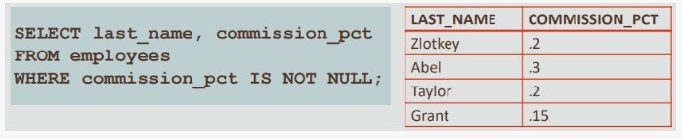
WHERE OPTION - IS NULL/ IS NOT NULL
Official (Open)
Notes:
Get column “last_name”, “manager_id” from employees table where column “manager_id” has no value in it
Get column “last_name”, “commission_pct” from employees table where column “commission_pct” has value in it

Slide 23
DISTINCT
Official (Open)
Name | Gender | adminNo | Marks
Irfan | M | 111222A | 97
Julia | F | 114435B | 74
Kieran | M | 115623C | 90
Lucy | F | 112419D | 78
Mike | M | 118752E | 56
Sometimes we would like unique values of a column to be returned.
Example:
SELECT DISTINCT(gender)
FROM StudentInfo;
Result:
Gender
M
F
Notes:
Distinct is used to remove duplicates ?
Inside a table, a column often contains many duplicate values; and sometimes you only want to list the different (distinct) values.

Slide 24
Aggregate function: SUM
Official (Open)
Marks
97
74
90
78
56
Example:
Result:
TOTAL
SELECT SUM(marks) AS TOTAL
FROM StudentInfo;
395
NULL values in the column, if they exist, are ignored.
Notes:
Get the sum of the marks as total from StudentInfo
Rename marks to total

Slide 25
Aggregate function: SUM
Official (Open)
Name | Gender | adminNo | Marks
Irfan | M | 111222A | 97
Kieran | M | 115623C | 90
Mike | M | 118752E | 56
Example:
Result:
BOYS_SUM
SELECT SUM(marks) AS BOYS_SUM
FROM StudentInfo WHERE gender = ‘M’;
243
Notes:
Get the male sum by locating the male gender and add them together

Slide 26
Aggregate function: AVERAGE
Official (Open)
Marks
97
74
90
78
56
Example:
Result:
AVERAGE
SELECT AVG(marks) AS AVERAGE
FROM StudentInfo;
95

Slide 27
Aggregate function: COUNT
Official (Open)
Example:
Result:
NUMMARKS
SELECT COUNT(*) AS NUMMARKS
FROM StudentInfo;
5
Notes:
Sum and count is different
Count is how many you have like in one variable

Slide 28
To Note:
Official (Open)
Character strings and dates in the WHERE clause must be enclosed in single quotation marks ' ‘.
Numbers, however, should not be enclosed in single quotation marks.
Example:
WHERE hire_date < '01-Jan-2000’ WHERE salary >= 6000
WHERE job_id = 'IT_PROG'
All character searches are case-sensitive!

Slide 29
GROUP BY
Official (Open)
GROUP BY <column> will return 1 or more groups depending on the number of unique values in the column.
If column has 2 unique values (e.g. gender), then two groups are returned.
We need an aggregate function (eg. SUM(), AVG(), COUNT()) for each group. Syntax:
SELECT <aggregrate function> FROM <tablename>
GROUP BY <columnname>;

Slide 30
GROUP BY – Example
Official (Open)
Name | Gender | adminNo | Marks
Irfan | M | 111222A | 97
Julia | F | 114435B | 74
Kieran | M | 115623C | 90
Lucy | F | 112419D | 78
Mike | M | 118752E | 56
Example:
SELECT SUM(marks) AS TOTAL
FROM StudentInfo GROUP BY gender;
Result:
TOTAL
152
243
Because there are 2 unique values for column ‘gender’, so 2 rows are returned.
Notes:
Group the data by gender column
Take all the M and sum their mark together
Take all the F and sum them together
Therefore, it group and calculate how many people each gender have

Slide 31
GROUP BY – Example 1
Official (Open)
Example:
SELECT Gender, SUM(marks) AS TOTAL FROM StudentInfo
GROUP BY gender;
Result:
Gender | TOTAL
F | 152
M | 243
Notes:
This one there is extra “Gender” for displaying the name

Slide 32
GROUP BY – Example 2
Official (Open)
Name | Gender | adminNo | Marks
Irfan | M | 111222A | 97
Julia | F | 114435B | 74
Kieran | M | 115623C | 90
Lucy | F | 112419D | 78
Mike | M | 118752E | 56
Example:
SELECT Gender, COUNT(*) AS NUMBER
FROM StudentInfo GROUP BY gender;
Result:
Gender | NUMBER
F | 2
M | 3
Notes:
Count how many female and male are inside the table

